Slide 1
Sorting Algorithms

Slide 2
Agenda
Sorting
Definition
Applications
Sorting algorithms and their analysis
Insertion Sort
Bubble Sort
Selection Sort
Merge Sort
Quick Sort

Slide 3
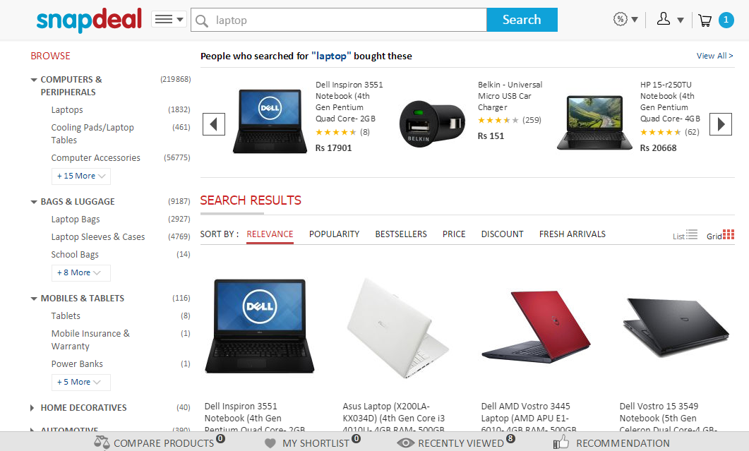
We use Sorting…

Slide 4
Sorting:Definition
Sorting: arranging elements in a list or collection in increasing or decreasing order of some property.
A = { 3 1 6 2 1 3 4 5 9 0 }
A = { 0 1 1 2 3 3 4 5 6 9 }

Slide 5
Applications of sorting
Sorting is useful in:
Searching in database.
Binary Search
Closest Pair
Element Uniqueness.

Slide 6




Stable Sort Vs Unstable Sort
UNSTABLE

Slide 7
Stable Sort Vs Unstable Sort
STABLE

Slide 8
Different sorting algorithms
Some sorting algorithms are:-
Insertion Sort
Bubble Sort
Selection Sort
Merge Sort
Quick Sort
Heap Sort

Slide 9
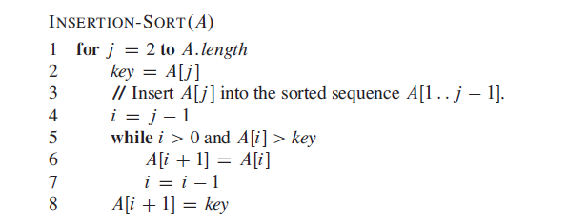
Insertion Sort Algorithm

Slide 10






Example
Show how this algorithm works for A =[5, 2, 4, 6, 1,3]

Slide 11
Insertion Sort Time Analysis
Steps of algorithm:
for i = 1 to n-1
take next key from unsorted part of array
insert in appropriate location in sorted part of array:
increase size of sorted array by 1
for j = i down to 0,
shift sorted elements to the right if key >key[i]
Time complexity is hence O(n²).

Slide 12
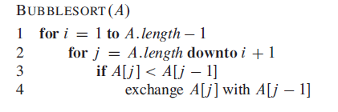
Bubble Sort Algorithm
Time Complexity: O(n²).

Slide 13
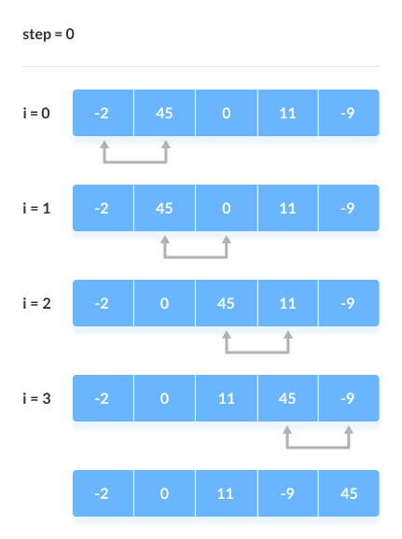
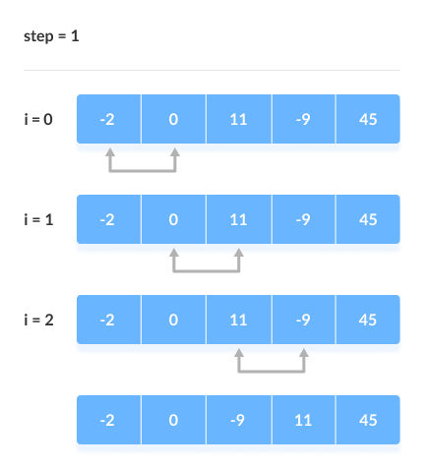
Example

Slide 14
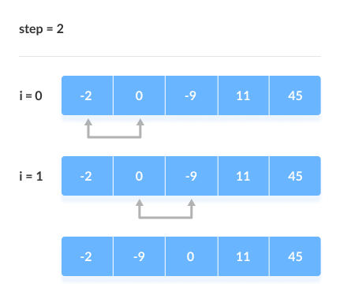
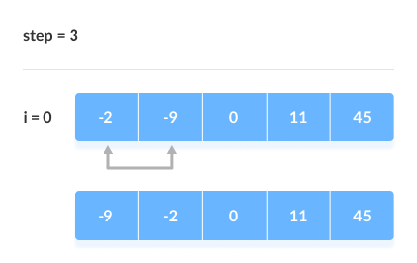
Contd..

Slide 15
Merge Sort
Divide-and-conquer based algorithm:
Divide the unsorted array into 2 halves until the sub-arrays only contain one element
Merge the sub-problem solutions together:
Compare the sub-array’s first elements
Remove the smallest element and put it into the result array
Continue the process until all elements have been put into the result array

Slide 16
Idea
Mergesort(Passed an array)
if array size > 1
Divide array in half
Call Mergesort on first half.
Call Mergesort on second half.
Merge two halves.
Merge(Passed two arrays)
Compare leading element in each array
Select lower and place in new array.
(If one input array is empty then place
remainder of other array in output array)

Slide 17
Algorithm
MERGE-SORT(A, p, r)
1 if p < r
2 then q ← (p + r)/2
3 MERGE-SORT(A, p, q)
4 MERGE-SORT(A, q + 1, r)
5 MERGE(A, p, q, r)

Slide 18
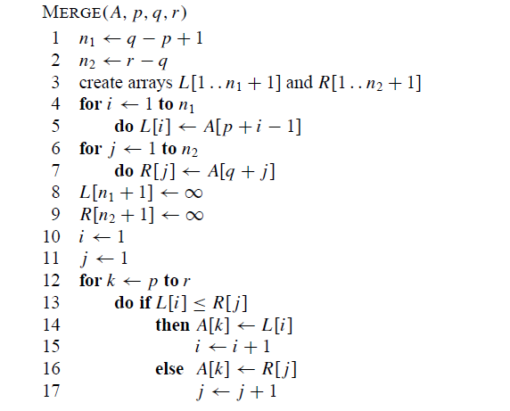
Merge

Slide 19
98
23
45
14
6
67
33
42

Slide 20
98
23
45
14
6
67
33
42
98
23
45
14
6
67
33
42

Slide 21
98
23
45
14
6
67
33
42
98
23
45
14
6
67
33
42
98
23
45
14

Slide 22
98
23
45
14
6
67
33
42
98
23
45
14
6
67
33
42
98
23
45
14
98
23

Slide 23
98
23
45
14
6
67
33
42
98
23
45
14
6
67
33
42
98
23
45
14
98
23
Merge

Slide 24
98
23
45
14
6
67
33
42
98
23
45
14
6
67
33
42
98
23
45
14
98
23
23
Merge

Slide 25
98
23
45
14
6
67
33
42
98
23
45
14
6
67
33
42
98
23
45
14
98
23
23
98
Merge

Slide 26
98
23
45
14
6
67
33
42
98
23
45
14
6
67
33
42
98
23
45
14
98
23
45
14
23
98

Slide 27
98
23
45
14
6
67
33
42
98
23
45
14
6
67
33
42
98
23
45
14
98
23
45
14
23
98
Merge

Slide 28
98
23
45
14
6
67
33
42
98
23
45
14
6
67
33
42
98
23
45
14
98
23
45
14
23
98
14
Merge

Slide 29
98
23
45
14
6
67
33
42
98
23
45
14
6
67
33
42
98
23
45
14
98
23
45
14
23
98
14
45
Merge

Slide 30
98
23
45
14
6
67
33
42
98
23
45
14
6
67
33
42
98
23
45
14
98
23
45
14
23
98
14
45
Merge

Slide 31
98
23
45
14
6
67
33
42
98
23
45
14
6
67
33
42
98
23
45
14
98
23
45
14
23
98
14
45
14
Merge

Slide 32
98
23
45
14
6
67
33
42
98
23
45
14
6
67
33
42
98
23
45
14
98
23
45
14
23
98
14
45
14
23
Merge

Slide 33
98
23
45
14
6
67
33
42
98
23
45
14
6
67
33
42
98
23
45
14
98
23
45
14
23
98
14
45
14
23
45
Merge

Slide 34
98
23
45
14
6
67
33
42
98
23
45
14
6
67
33
42
98
23
45
14
98
23
45
14
23
98
14
45
14
23
45
98
Merge

Slide 35
98
23
45
14
6
67
33
42
98
23
45
14
6
67
33
42
98
23
45
14
6
67
33
42
98
23
45
14
23
98
14
45
14
23
45
98

Slide 36
98
23
45
14
6
67
33
42
98
23
45
14
6
67
33
42
98
23
45
14
6
67
33
42
98
23
45
14
6
67
23
98
14
45
14
23
45
98

Slide 37
98
23
45
14
6
67
33
42
98
23
45
14
6
67
33
42
98
23
45
14
6
67
33
42
98
23
45
14
6
67
23
98
14
45
14
23
45
98
Merge

Slide 38
98
23
45
14
6
67
33
42
98
23
45
14
6
67
33
42
98
23
45
14
6
67
33
42
98
23
45
14
6
67
23
98
14
45
6
14
23
45
98
Merge

Slide 39
98
23
45
14
6
67
33
42
98
23
45
14
6
67
33
42
98
23
45
14
6
67
33
42
98
23
45
14
6
67
23
98
14
45
6
67
14
23
45
98
Merge

Slide 40
98
23
45
14
6
67
33
42
98
23
45
14
6
67
33
42
98
23
45
14
6
67
33
42
98
23
45
14
6
67
33
42
23
98
14
45
6
67
14
23
45
98

Slide 41
98
23
45
14
6
67
33
42
98
23
45
14
6
67
33
42
98
23
45
14
6
67
33
42
98
23
45
14
6
67
33
42
23
98
14
45
6
67
14
23
45
98
Merge

Slide 42
98
23
45
14
6
67
33
42
98
23
45
14
6
67
33
42
98
23
45
14
6
67
33
42
98
23
45
14
6
67
33
42
23
98
14
45
6
67
33
14
23
45
98
Merge

Slide 43
98
23
45
14
6
67
33
42
98
23
45
14
6
67
33
42
98
23
45
14
6
67
33
42
98
23
45
14
6
67
33
42
23
98
14
45
6
67
33
42
14
23
45
98
Merge

Slide 44
98
23
45
14
6
67
33
42
98
23
45
14
6
67
33
42
98
23
45
14
6
67
33
42
98
23
45
14
6
67
33
42
23
98
14
45
6
67
33
42
14
23
45
98
Merge

Slide 45
98
23
45
14
6
67
33
42
98
23
45
14
6
67
33
42
98
23
45
14
6
67
33
42
98
23
45
14
6
67
33
42
23
98
14
45
6
67
33
42
14
23
45
98
6
Merge

Slide 46
98
23
45
14
6
67
33
42
98
23
45
14
6
67
33
42
98
23
45
14
6
67
33
42
98
23
45
14
6
67
33
42
23
98
14
45
6
67
33
42
14
23
45
98
6
33
Merge

Slide 47
98
23
45
14
6
67
33
42
98
23
45
14
6
67
33
42
98
23
45
14
6
67
33
42
98
23
45
14
6
67
33
42
23
98
14
45
6
67
33
42
14
23
45
98
6
33
42
Merge

Slide 48
98
23
45
14
6
67
33
42
98
23
45
14
6
67
33
42
98
23
45
14
6
67
33
42
98
23
45
14
6
67
33
42
23
98
14
45
6
67
33
42
14
23
45
98
6
33
42
67
Merge

Slide 49
98
23
45
14
6
67
33
42
98
23
45
14
6
67
33
42
98
23
45
14
6
67
33
42
98
23
45
14
6
67
33
42
23
98
14
45
6
67
33
42
14
23
45
98
6
33
42
67
Merge

Slide 50
98
23
45
14
6
67
33
42
98
23
45
14
6
67
33
42
98
23
45
14
6
67
33
42
98
23
45
14
6
67
33
42
23
98
14
45
6
67
33
42
14
23
45
98
6
33
42
67
6
Merge

Slide 51
98
23
45
14
6
67
33
42
98
23
45
14
6
67
33
42
98
23
45
14
6
67
33
42
98
23
45
14
6
67
33
42
23
98
14
45
6
67
33
42
14
23
45
98
6
33
42
67
6
14
Merge

Slide 52
98
23
45
14
6
67
33
42
98
23
45
14
6
67
33
42
98
23
45
14
6
67
33
42
98
23
45
14
6
67
33
42
23
98
14
45
6
67
33
42
14
23
45
98
6
33
42
67
6
14
23
Merge

Slide 53
98
23
45
14
6
67
33
42
98
23
45
14
6
67
33
42
98
23
45
14
6
67
33
42
98
23
45
14
6
67
33
42
23
98
14
45
6
67
33
42
14
23
45
98
6
33
42
67
6
14
23
33
Merge

Slide 54
98
23
45
14
6
67
33
42
98
23
45
14
6
67
33
42
98
23
45
14
6
67
33
42
98
23
45
14
6
67
33
42
23
98
14
45
6
67
33
42
14
23
45
98
6
33
42
67
6
14
23
33
42
Merge

Slide 55
98
23
45
14
6
67
33
42
98
23
45
14
6
67
33
42
98
23
45
14
6
67
33
42
98
23
45
14
6
67
33
42
23
98
14
45
6
67
33
42
14
23
45
98
6
33
42
67
6
14
23
33
42
45
Merge

Slide 56
98
23
45
14
6
67
33
42
98
23
45
14
6
67
33
42
98
23
45
14
6
67
33
42
98
23
45
14
6
67
33
42
23
98
14
45
6
67
33
42
14
23
45
98
6
33
42
67
6
14
23
33
42
45
67
Merge

Slide 57
98
23
45
14
6
67
33
42
98
23
45
14
6
67
33
42
98
23
45
14
6
67
33
42
98
23
45
14
6
67
33
42
23
98
14
45
6
67
33
42
14
23
45
98
6
33
42
67
6
14
23
33
42
45
67
98
Merge

Slide 58
98
23
45
14
6
67
33
42
98
23
45
14
6
67
33
42
98
23
45
14
6
67
33
42
98
23
45
14
6
67
33
42
23
98
14
45
6
67
33
42
14
23
45
98
6
33
42
67
6
14
23
33
42
45
67
98

Slide 59
98
23
45
14
6
67
33
42
6
14
23
33
42
45
67
98

Slide 60
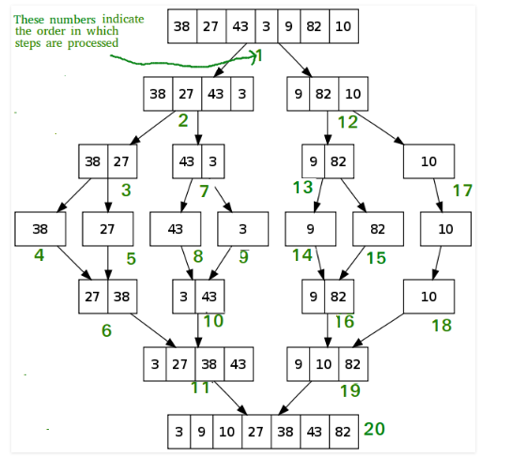
Example 2

Slide 61
Mergesort - Analysis
2^{m}
level 0 : 1 merge (size 2^{m-1})
2^{m-1}
2^{m-1}
level 1 : 2 merges (size 2^{m-2})
level 2 : 4 merges (size 2^{m-3})
2^{m-2}
2^{m-2}
2^{m-2}
2^{m-2}
.
.
.
.
.
.
level m-1 : 2^{m-1} merges (size 2⁰)
2⁰
2⁰
. . . . . . . . . . . . . . . . .
level m

Slide 62
Mergesort - Analysis
T (n) =c if n = 1 ,
=2T (n/2) + n if n > 1 ,
Worst-case –
➔ O (n * log₂n )

Slide 63
Quick Sort
Quicksort, like merge sort, applies the divide-and-conquer paradigm.
three-step divide-and-conquer process for sorting a typical subarray A[p…r]:
Divide:Partition (rearrange) the array A[p…r] into two (possibly empty) subarrays A[p…q-1] and A[q+1…r] such that each element of A[p…q-1] is less than or equal to A[q], which is, in turn, less than or equal to each element of A[q+1…r]. Compute the index q as part of this partitioning procedure.
Conquer: Sort the two subarrays A[p…q-1] and [q+1…r] by recursive calls to quicksort.
Combine: Because the subarrays are already sorted, no work is needed to combine them: the entire array A[p…r] is now sorted

Slide 64
Algorithm
QUICKSORT(A, p, r)
1 if(p < r)
2 q=PARTITION(A, p, r)
3 QUICKSORT(A, p, q-1)
4 QUICKSORT(A, q+1,r)
PARTITION(A, p, r)
1 x=A[r] //pivot element
2 i = p-1
3 for j = p to r - 1
4 if A[j]<=x
5 i =i+1
6 exchange A[i] with A[j]
7 exchange A[i+1]with A[r]
8 return i +1
To sort an entire array A, the initial call is QUICKSORT(A, 1, A.length)

Slide 65









Example

Slide 66
Performance of quicksort
The running time of quicksort depends on whether the partitioning is balanced or unbalanced, which in turn depends on which elements are used for partitioning.
If the partitioning is balanced, the algorithm runs asymptotically as fast as merge sort.
If the partitioning is unbalanced, however, it can run asymptotically as slowly as insertion sort.

Slide 67
Worst-case partitioning
The worst-case behavior for quicksort occurs when the partitioning routine produces one subproblem with n-1 elements and one with 0 elements.
The partitioning costs Ɵ (n) time. Since the recursive call on an array of size 0 just returns, T(0) = Ɵ (1), and the recurrence for the running time is
T(n)=T(n-1)+T(0)+ Ɵ(n)
= T(n-1)+ Ɵ(n)
Which evaluates to Ɵ(n²)

Slide 68
Best-case partitioning
In the most even possible split, PARTITION produces two subproblems, each of size no more than n/2.
In this case, quicksort runs much faster. The recurrence for the running time is then
T(n)=2T(n/2)+ Ɵ(n)
Which evaluates to Ɵ(n lg n)(Master Theorem Case 2)
The average-case running time of quicksort is much closer to the best case than to the worst case

